Slide 1
Solution to address change in the number of birds in our locality
Rishi K Prasad and Samarth Saiboyani
Grade - 8

Slide 2
Introduction
Bengaluru, Silicon valley is known as Garden city of India.
We, the residents of Bengaluru desire to have a biodiverse environment around us.
Bird is one of the most beautiful species which we are enthralled to watch in the city.
They are recently becoming a rarer sight.
Birdwatchers have estimated declines of around 80%-90% in species.

Slide 3
Objectives
Researching about the type and number of birds in our locality.
To find out the best possible solution for threats on birds nowadays.

Slide 4
Materials and Methodology
Materials:-
Camera
Binoculars
Methods:-
Checking colour of the birds.
Checking the eating habits of the birds.

Slide 5
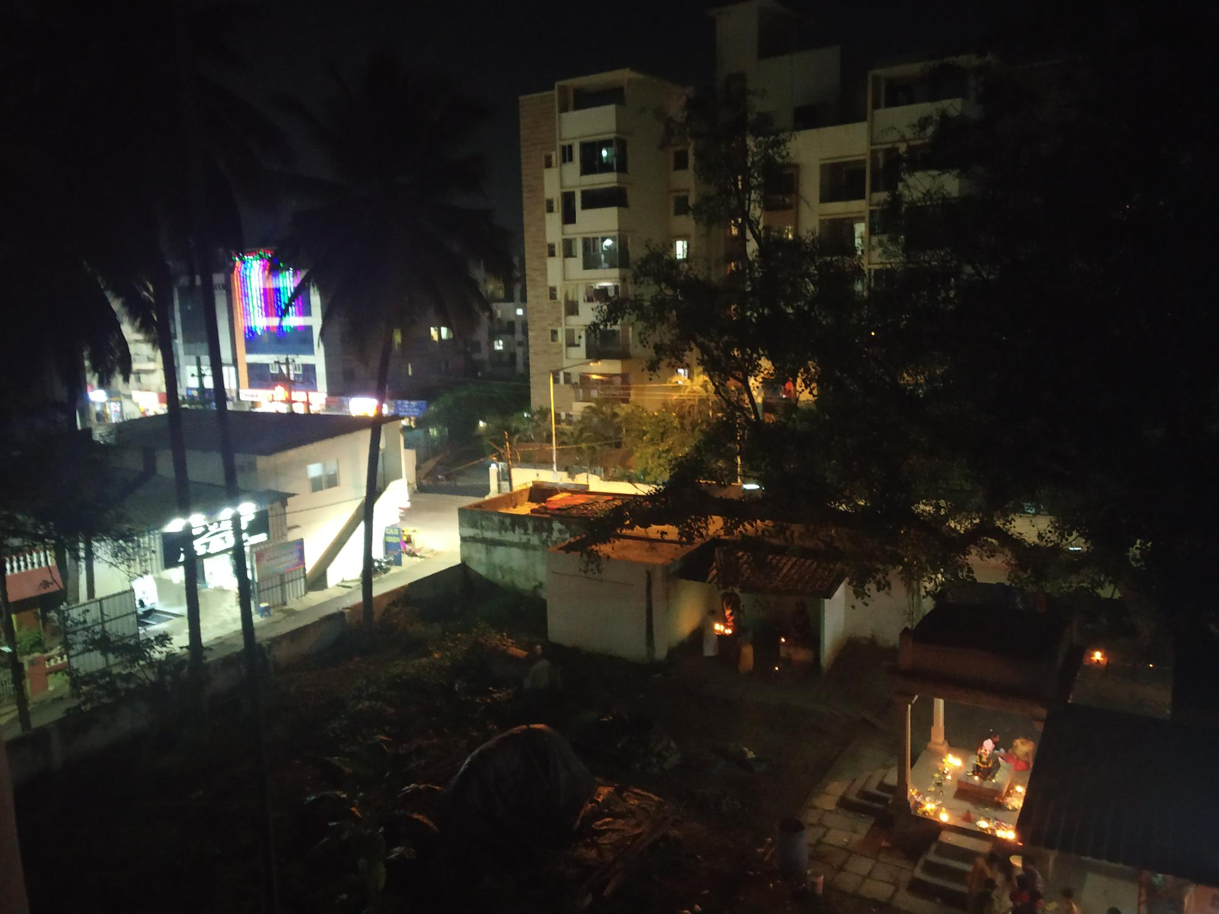
Area of research
Basavanagara

Slide 6
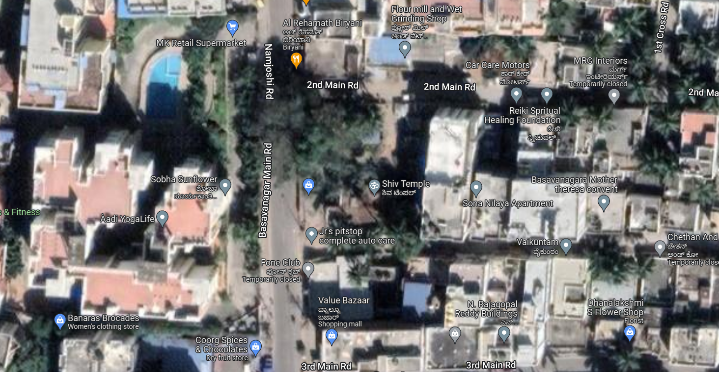
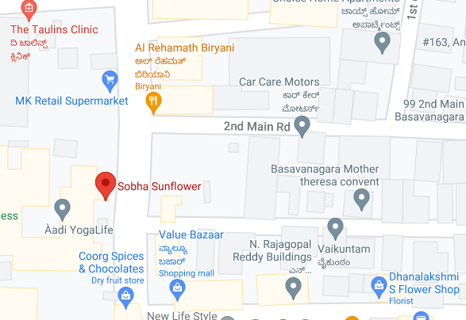
Mapping
Satellite view
Our research area is 9.433 km²
Longitude: 12º58’03”N
Latitude : 77º40’58”E
Aerial view

Slide 7
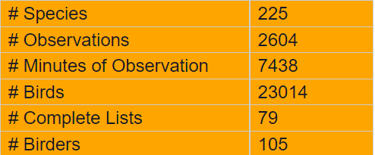
Count of birds in Bangalore
According to bird census as on 16 February 2014 in Bangalore
According to bird census as on 2015 in Bangalore, there are 411 species of birds
According to recent bird census as on 2022 in Bangalore, there are 331 species of birds

Slide 8
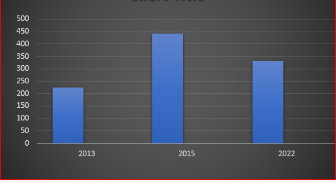
Comparing the records
Number of species of birds
411
331
225
Year

Slide 9
Sl no. | Name | Picture | IUCN Red List | Food Category
1 | Blue rock pigeon |  | Decreasing | Herbivores
2 | Common Raven |  | Increasing | Omnivore
3 | Cattle egret |  | Increasing | Insectivore
4 | Blue rock thrush |  | Stable | Omnivore
5 | House sparrows |  | Decreasing | Herbivore
6 | Rose-Ringed Parakeet |  | Increasing | Insectivore
7 | Black Kite |  | Stable | Carnivore Scavenger

Slide 10
Sl no. | Common name | Vernacular name | Scientific name | Average number | Observation timing | Month of observation | Activity
1 | Blue rock pigeon | ಪಾರಿವಾಳ | Columba Livia |  | 7:30am-8:15am 5:45pm-6:20pm | Throughout the year | on ground, while feeding, on window, Flying
2 | Common Raven | ಕಾಗೆ | Corvus corax |  | 7:30am-8:00am 5:00pm-5:45pm | Throughout the year | On ground, flying
3 | Cattle egret | ಬೆಳ್ಳಕ್ಕಿ | Bubulcus ibis |  | 7:15am-7:45am 4:00pm-5:15 | Throughout the year | On ground, branches of trees
4 | Blue rock thrush | ನೀಲಿ ಬಂಡೆಸಿಳ್ಳಾರ | Monticola solitarius |  | 7:00am-7:30am 3:00pm-4:00pm | January | On window
5 | House sparrows | ಗುಬ್ಬಚ್ಚಿಗಳು | Passer domesticus |  | 7:30am-8:00am 5:00pm-5:30pm | August -September | On window, On terrace
6 | Rose-Ringed Parakeet | ಗಿಳಿ | Psittacula krameri |  | 4:30pm-5:30pm | September - December | Flying, Sitting near exhaust fan, On branch of trees, on Windows
7 | Black Kite | ಹದ್ದು | Milvus migrans |  | 4:00pm-5:00pm | August - september | Sitting on trees, flying

Slide 11
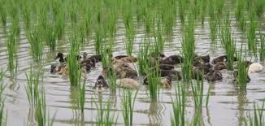
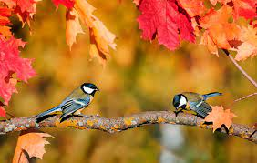
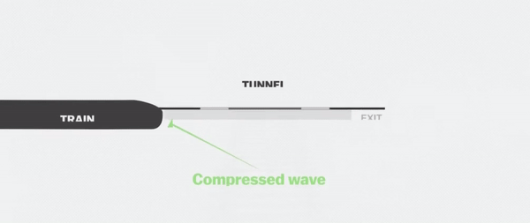
If birds are eliminated from the ecosystem by human tech, the ecosystem will collapse.
Birds and ecosystem
we are influenced by birds in many ways
It's our duty to take care of our ecosystem and hence the birds
Dornier -228

Slide 12
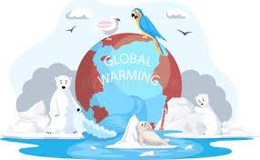
Threat for birds
Young Sparrows die due to mobile tower radiation
Bird wings get tangled by kites
Birds hit windows
Global warming

Slide 13
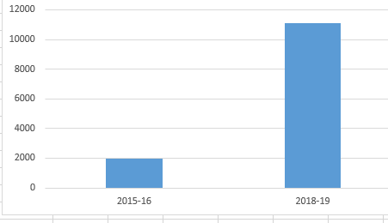
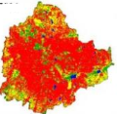
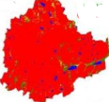
Comparing the deforestation records
11,078
Number of trees cut
1,983
Year
2015-16
2018-19

Slide 14
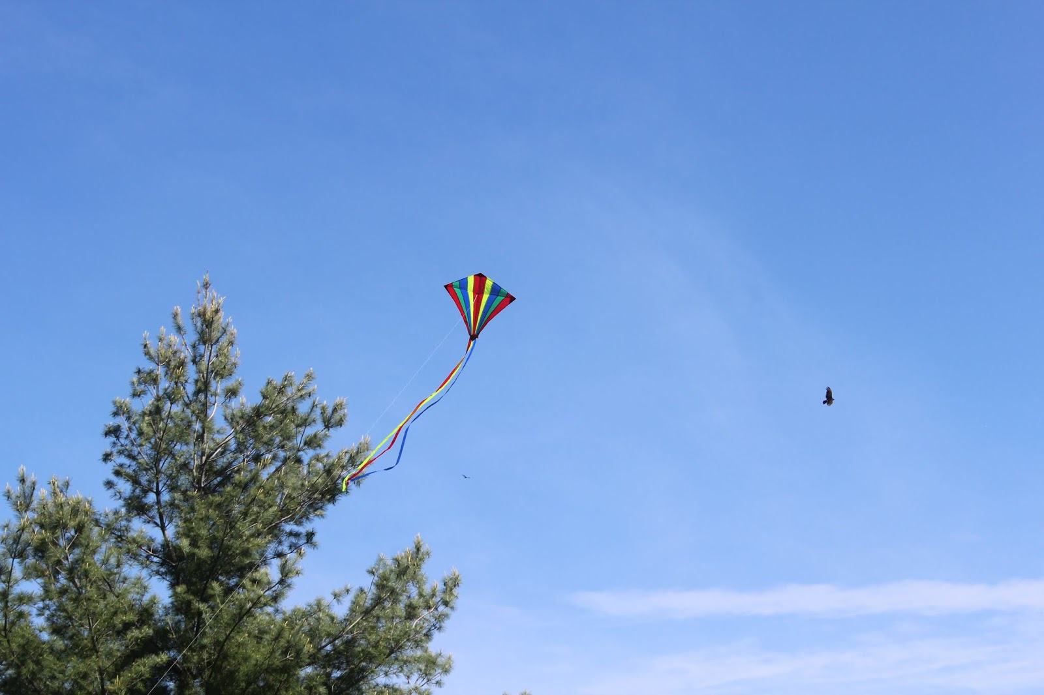
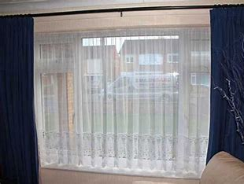
Solution
Do
Dont'S
Afforestation
Close windows with curtain or use net as curtain.
Natural habitat of birds should be preserved.
Fly kites less than 45 meter from ground level
Deforestation
Not attaching net or curtains in the windows
Keeping birds in cages for our entertainment.
Flying kites very high in sky.

Slide 15
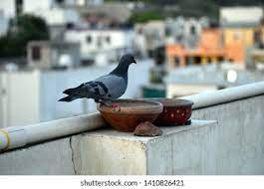
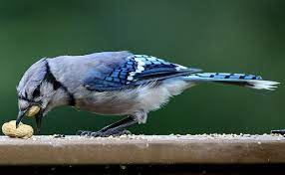
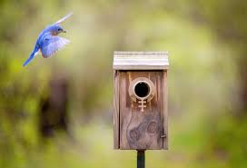
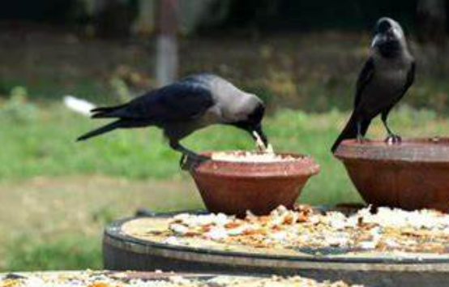
Stop firecracker
Keeping bowls full of water in terrace or balcony
Some other Steps
Reduce noise pollution
Plant more trees
And protect the older ones
Giving food like grains, nuts, etc. Every day
Make artificial bird nest in parks

Slide 16
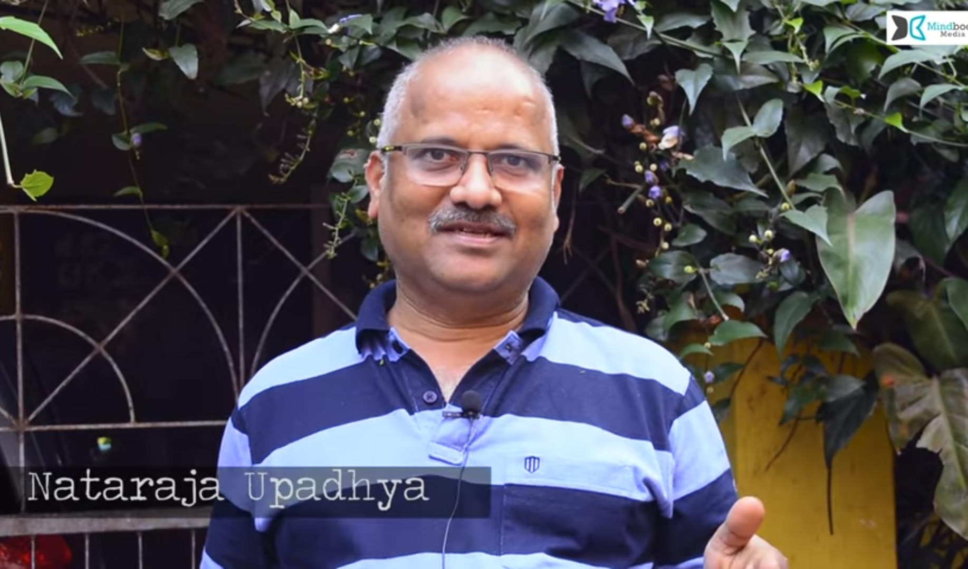
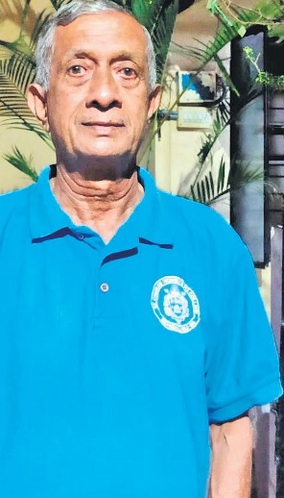
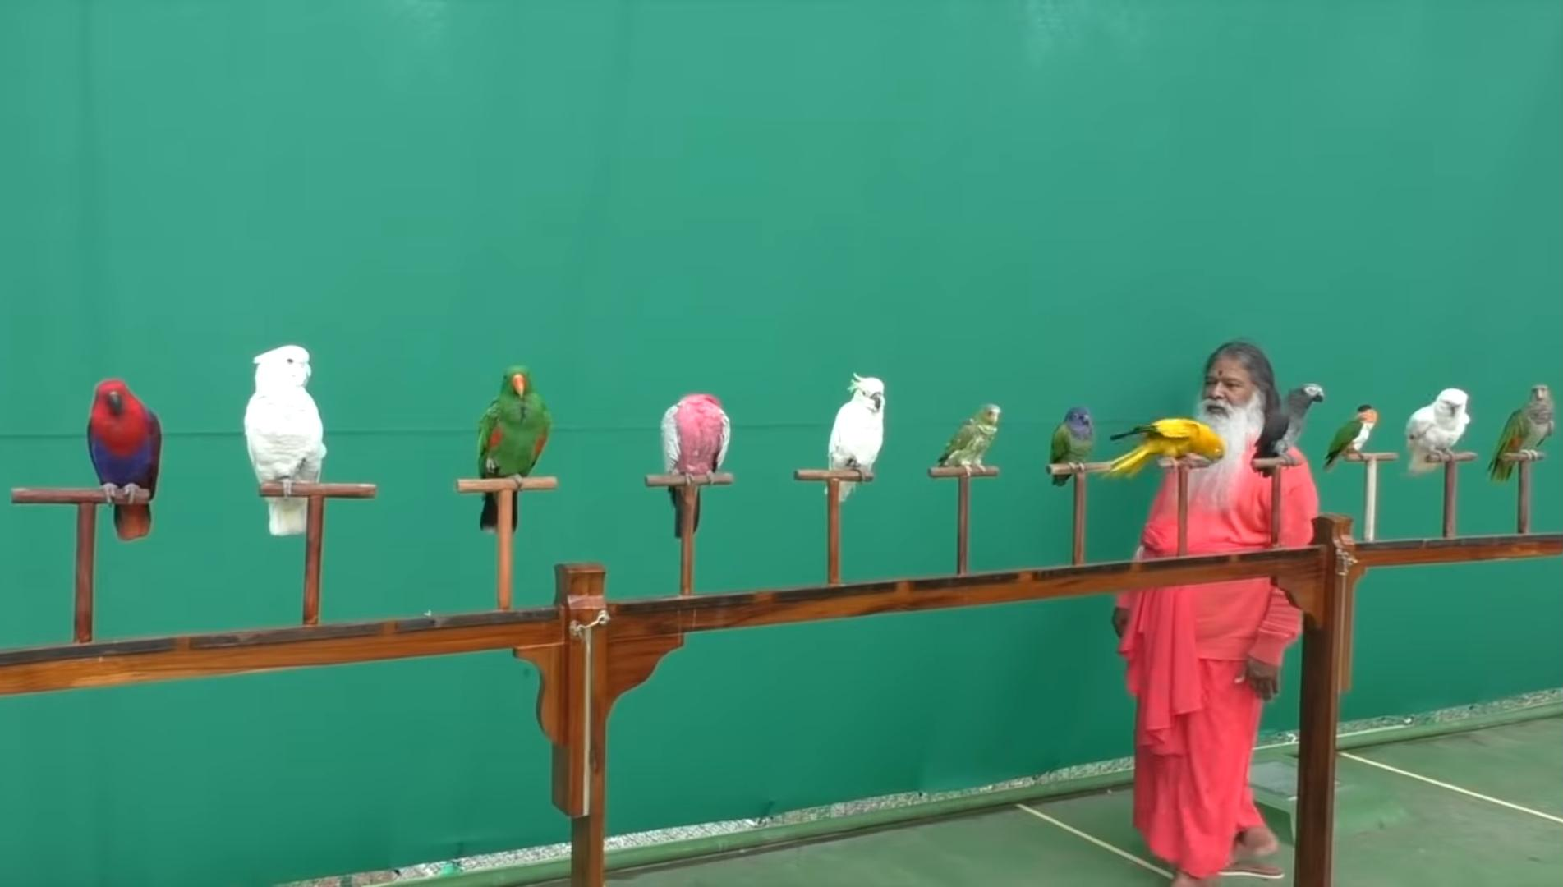
Some people who are contributing in saving birds
Nataraja Upadhya
Nataraja Upadhya made an urban evergreen jungle at his house terrace in four layers. He grew plants in recycled plastic bins. In this place he has many fruits and vegetables with a tub of water. Here birds come to eat and rest.
Sri Ganapathy Sachchidananda (Shuka Maharishi) is a man who made a place to save parrots
Edwin Joseph made his home to a bird shelter where more than 200 birds come everyday
Edwin Joseph
Sri Ganapathy Sachchidananda

Slide 17
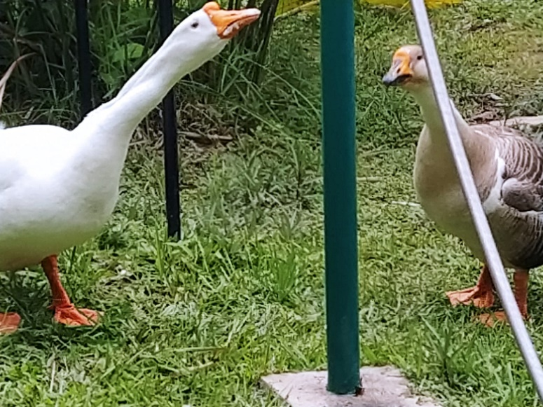
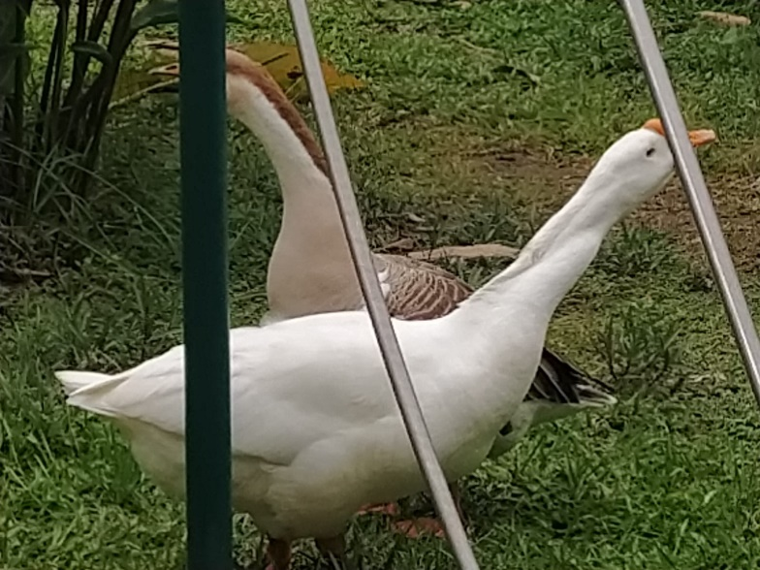
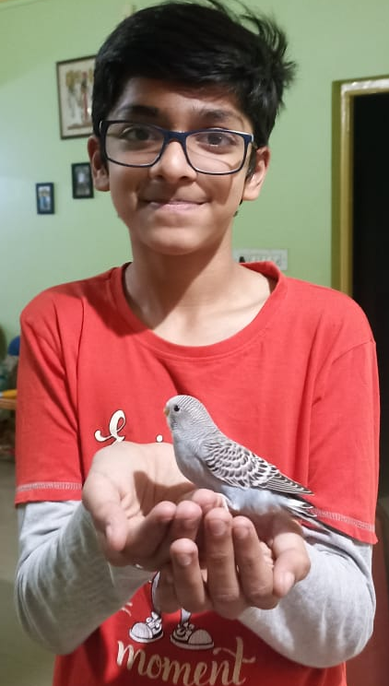
Swan in our school
Feeding birds in our apartment

Slide 18
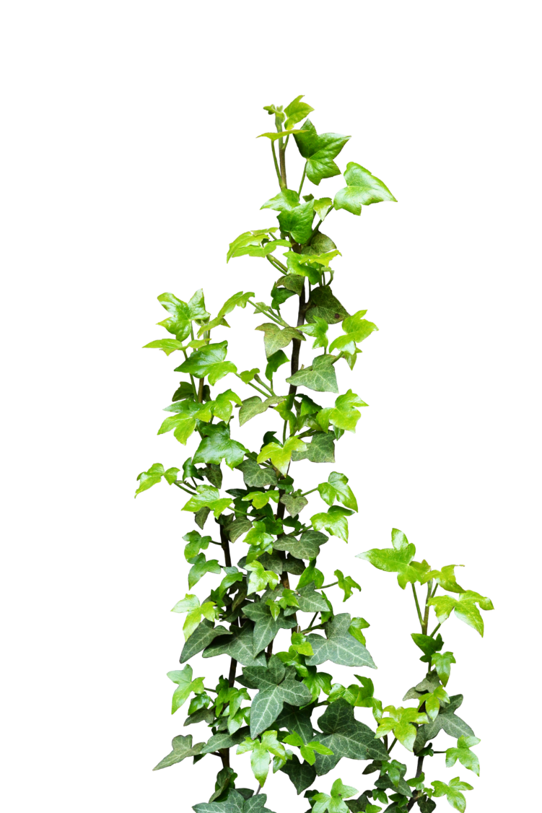
Acknowledgement
We are Thankful to IISc for giving us this wonderful opportunity
We are thankful to Vagdevi Vilas School, Marathahalli for allowing us to participate in this program.
We are Thankful to all our teachers who helped us in this project.
We are also Thankful to all our friends who helped us in the project.

Slide 19
References
https://wgbis.ces.iisc.ernet.in/energy/lake2022
https://avibase.bsc-eoc.org
https://ebird.org
https://www.inaturalist.org
https://www.vvi.edu.in
https://www.iucnredlist.org
https://animalia.bio

Slide 20
Thank You

